Slide 1
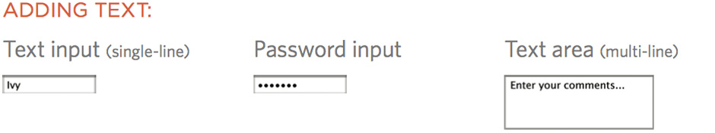
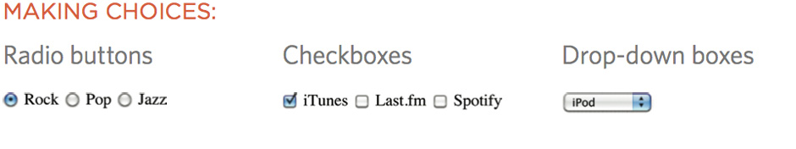
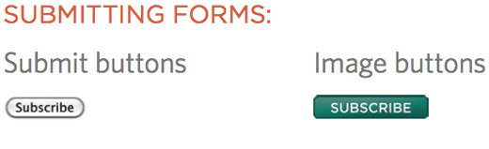
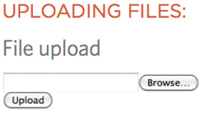
FORM CONTROLS
Notes:
Explain: how there are different types of form control
You need to choose the right type of control to get the information you need
Click: ways to provide text
Click: ways to make choices between fixed options
Click: ways to submit information
Click: how to upload files

Slide 2
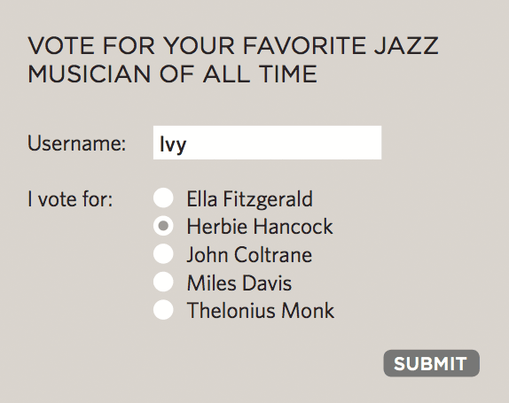
HOW FORMS WORK
1: User fills in form and presses button to submit info to server
Notes:
Explain: Each form control has a name and a value which is sent to the server.

Slide 3
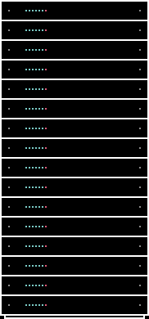
HOW FORMS WORK
3: Server processes information using programming language
Notes:
Explain: How servers process information using programming language

Slide 4
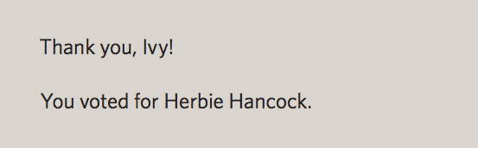
HOW FORMS WORK
4: Server creates new page to send back to the browser based
on info received
Notes:
Explain: The server returns a page to the user based on the information supplied in the form. Note that this will largely contain HTML & CSS. (It's not just a hand-coded page, it is based on templates.)

Slide 5
TEXT ENTRY CONTROLS
Enter text information with either a single line of text (input) or multiple lines (textarea).
Notes:
Explain: how the server needs to know what the user entered / chose for each different form element
To do this, each form element must have a name
The value is what the user enters / the value associated with the choice made

Slide 6
INPUT
For entering a single line of text.
<form>
<p>Username:
<input type="text" name="username"/>
</p>
</form>
Notes:
Explain: The type attribute is used to indicate which type of control you want.

Slide 7
TYPE ATTRIBUTE
Indicates which type of control you want.
<form>
<p>Username:
<input type="text" name="username"/>
</p>
</form>
Notes:
Explain: The type attribute is used to indicate which type of control you want.

Slide 8
NAME ATTRIBUTE
Required. Names the form control element for processing. There are specific variable names that need to be used.
<form>
<p>Username:
<input type="text" name="username"/>
</p>
</form>
Notes:
Explain: You can’t just name controls willy-nilly. The web application that processes the data is programmed to look for specific variable names.

Slide 9
VALUE ATTRIBUTE
Specifies default text that appears in the field when the form is loaded. In this example, the value “username” will be sent with the form unless the user changes it.
<p>Username:
<input type="text" name="username"
value=”username" />
</p>
<p>Password:
<input type="password" name="password"/>
</p>
Notes:
Explain: The password attribute does not mean what is entered is secure. It just stops people from being able to read the characters when looking over the shoulder of the user entering them.

Slide 10
PASSWORD
The characters are obscured from view by asterisk (*) or bullet (•)
<p>Username:
<input type="text" name="username"
value=”username" />
</p>
<p>Password:
<input type="password" name="password"/>
</p>
Notes:
Explain: The password attribute does not mean what is entered is secure. It just stops people from being able to read the characters when looking over the shoulder of the user entering them.

Slide 11
TEXTAREA
Text fields that can span several lines
<p>What did you think of this gig?</p>
<textarea name="comments">
Enter your comments...
<textarea/>

Slide 12
NAME ATTRIBUTE
Required. Names the form control element for processing. There are specific variable names that need to be used.
<p>What did you think of this gig?</p>
<textarea name="comments">
Enter your comments...
<textarea/>

Slide 13
SUBMIT BUTTON
When clicked or tapped, the submit button immediately sends the collected form data to the server for processing.
<form action="http://eg.com/email.php">
<p>Subscribe to our email list:</p>
<input type="text" name="email" />
<input type="submit"
value="Subscribe" />
</form>

Slide 14
TYPE ATTRIBUTE
Type attribute indicates that it is a submit button.
<form action="http://eg.com/email.php">
<p>Subscribe to our email list:</p>
<input type="text" name="email" />
<input type="submit"
value="Subscribe" />
</form>

Slide 15
VALUE ATTRIBUTE
The value is what appears on the button.
<form action="http://eg.com/email.php">
<p>Subscribe to our email list:</p>
<input type="text" name="email" />
<input type="submit"
value="Subscribe" />
</form>
Notes:
Explain: The value is what appears on the button. (It is important to specify this.)

Slide 16
HTML5: SEARCH INPUT
Well supported by the latest browsers, although there may be inconsistencies in the way they are handled.
<input type="search" name="search"
placeholder="Enter keyword" />
<input type="submit" value="Search" />
Notes:
Explain: Older browsers show text input. Also note that the Safari browser adds styling.

Slide 17
TYPE ATTRIBUTE
Type attribute indicates that it is a search box.
<input type="search" name="search"
placeholder="Enter keyword" />
<input type="submit" value="Search" />

Slide 18
PLACEHOLDER ATTRIBUTE
Provides a hint of what to type in the field. The value of placeholder is not submitted with the form, and is purely a user interface enhancement.
<input type="search" name="search"
placeholder="Enter keyword" />
<input type="submit" value="Search" />

Slide 19
VALUE ATTRIBUTE
The value is what appears on the button.
<input type="search" name="search"
placeholder="Enter keyword" />
<input type="submit" value="Search" />

